Slide 1
Towards Trustworthy Feature Importance by Avoiding Unrestricted Permutations
Emanuele Borgonovo, Francesco Cappelli, Xuefei Lu, Elmar Plischke and Cynthia Rudin
Presenter: Emanuele Borgonovo
Bocconi Institute for Data Science and Analytics
emanuele.Borgonovo@unibocconi.it

Slide 2




Joint work with
Francesco Cappelli
University of Tuscia, Rome
Xuefei Lu
Skema, Business School Paris
Elmar Plischke
HZDR, Dresden
Cynthia Rudin
Duke University

Slide 3
Variable Importance and Explainability
Variable importance (“VI”) is a HUGE subject (i.e., XAI):
Guidotti et al. (ACM, 2018)
Murdoch et al. (PNAS, 2018)
Saltelli et al. (Nature, 2020)
Rudin et al . (JMLR, 2019)
Molnar et al. (2020)
Sundararajan and Najmi, (2020)
Slack et al., (2021)
Benard et al., (2022)
Verdinelli and Wasserman, (2023)
Scholbeck et. al. (2023)
Donnelly et al. (2024),
…, hundreds more
Notes:
Variable importance huge topic in explainable AI there is a tons of papers and I am going to talk about how to compute trustworthy variable importance

Slide 4
What features are important to the model? (Model explanation)
Does the model rely on “unfair” features?
Can we trust the model?
Do all good models rely on the same feature? (Rashomon Set)
On what variables should we focus managerial attention?
We need trustworthy VI indicators!
Do we have them? ….
Notes:
We want to know what features are important to the model, whether it relies on unfair features, we need trustworthy importance indicators, do we have them

Slide 5
Boston Housing
506 Houses
13 Features
What is the most important feature?
Notes:
Example: Boston housing dataset 1978, mean price 22.5, min 5, max 50, we want to know what is important feature. We use the SHAPS

Slide 6
Predictions within SHAPs calculations
Original Data
… seems not….
-650K$?
+900K$
Notes:
Now shaps involve evaluating new data, constructed varying something in the old data. In that calculation, we see that predictions are totally unrealistic, from negative 650k to 900k, while the original data is in here. How do you expect that the SHAPs computed from this data are trustworthy? Because they are not!

Slide 7
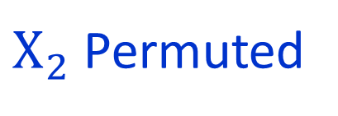
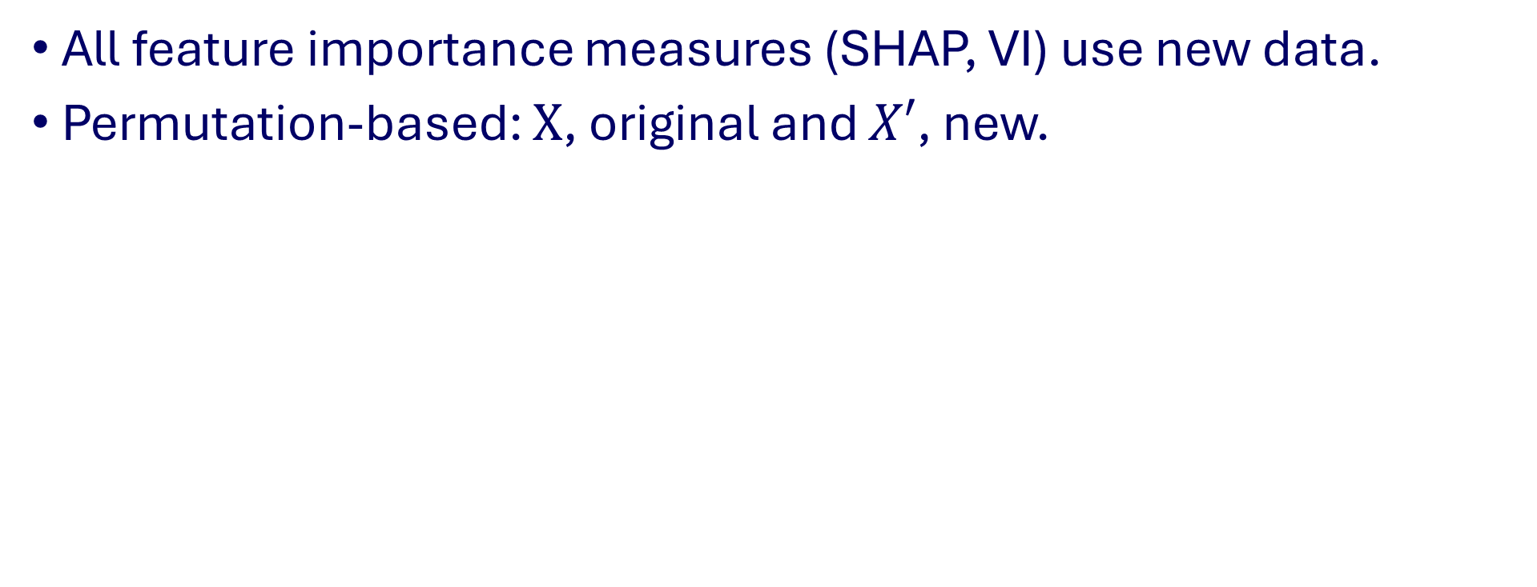
Extrapolation and Impossible Data
All feature importance measures (SHAP, VI) use new data.
Permutation-based: $X$, original and $X′$, new.
$X_{2}$ Permuted
’
New points may be unlikely or impossible data!
E.g., retired babies…
Notes:
All of the feature importance measures use data constructed from the original data. A lot of them are based on permutations. Let us show you what happens: look at column 2, ….

Slide 8
Long-Standing Problem: Extrapolation
Far or Impossible Data
Unreliable Model Predictions
Unreliable Variable Importance Calculations
(Hooker et al. (2021), Apley and Zhu (2020))

Slide 9
Two New Designs
To restrict permutations!
Notes:
To solve these long standing issues, we introduce two new methods

Slide 10
First New Design: GCMR
Permute only the variable’s unique information
Conditional Model Reliance + Gaussian Transformation
Permute only quantiles – always within range!
Notes:
The first new construction: GCMR

Slide 11
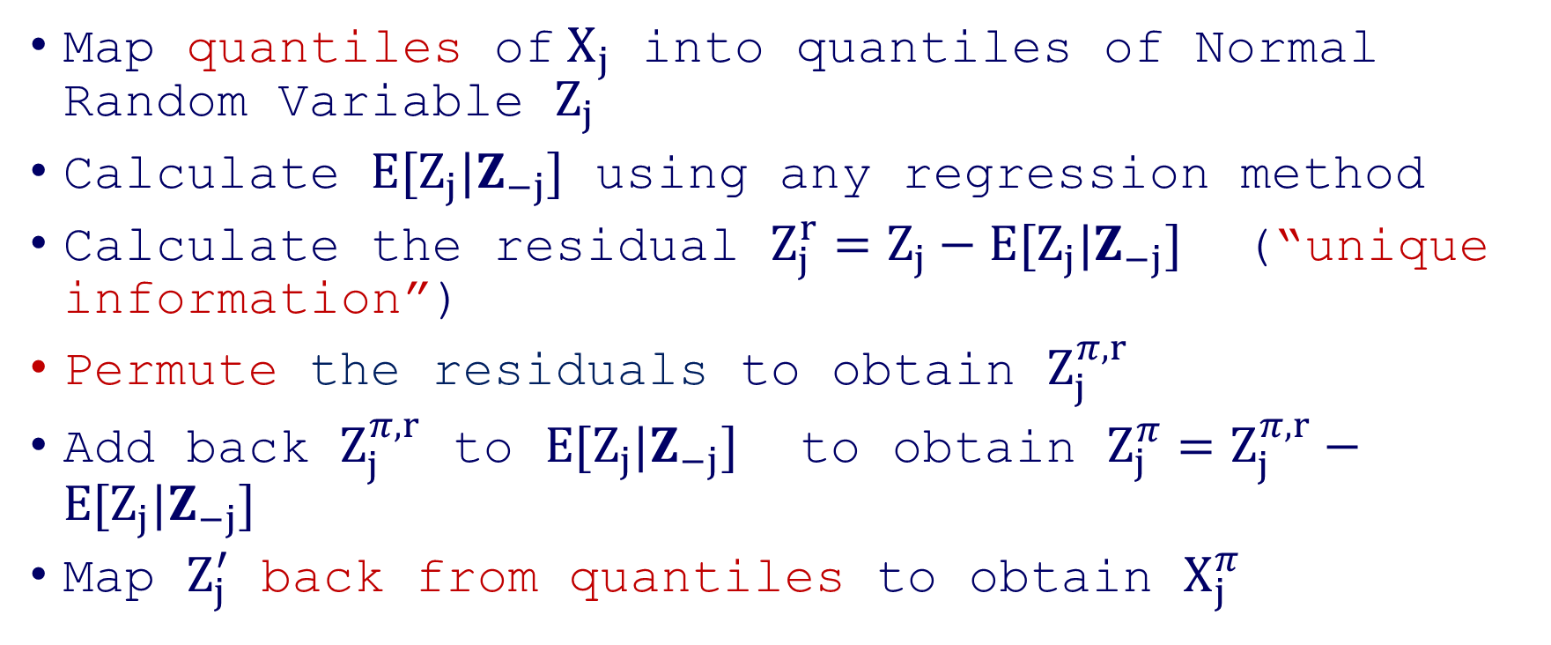
The GCMR Algorithm
Map quantiles of$X_{j}$ into quantiles of Normal Random Variable $Z_{j}$
Calculate $E[Z_{j}|Z_{−j}]$ using any regression method
Calculate the residual $Z_{j}^{r}=Z_{j}−E[Z_{j}|Z_{−j}]$ (“unique information”)
Permute the residuals to obtain $Z_{j}^{π, r}$
Add back $Z_{j}^{π, r}$ to $E[Z_{j}|Z_{−j}]$ to obtain $Z_{j}^{π}=Z_{j}^{π, r}−E[Z_{j}|Z_{−j}]$
Map $Z_{j}^{′}$ back from quantiles to obtain $X_{j}^{π}$

Slide 12
Step 1: Map quantiles of$X_{j}$ into quantiles of Normal Random Variable $Z_{j}$
Notes:
Triangular marginals correlated by a Gaussian Copula, mapped into normal

Slide 13

2: Non-Parametric Regression
$$E[Z_j|Z_{−j}]$$
3: Calculate Residuals

Slide 14
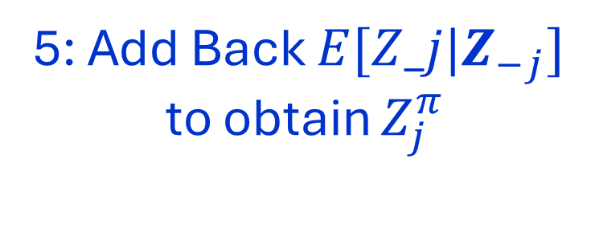
4: Permute Residuals
5: Add Back $E[Z_j|Z_{−j}]$
to obtain $Z_{j}^{π}$

Slide 15
5’: Permuted Gaussian
6: Map Back

Slide 17
GCMR Design: An Example
“Within Distribution”
Original Data (X)
New Data (X’)
Far

Slide 18
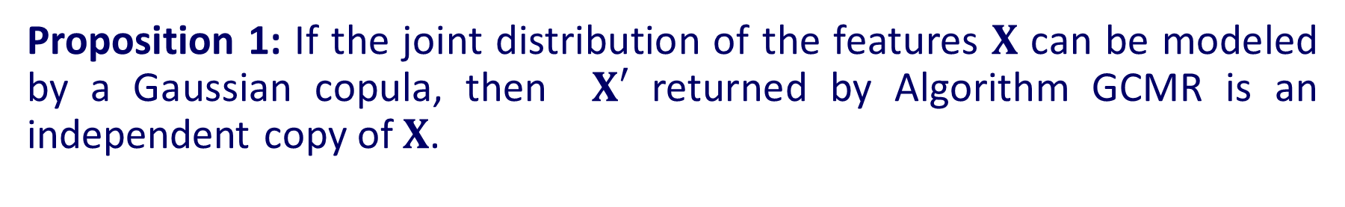
Theoretical Guarantee
Proposition 1: If the joint distribution of the features $X$ can be modeled by a Gaussian copula, then $X′$ returned by Algorithm GCMR is an independent copy of $X$.

Slide 19
Second New Design: GKnock
Knockoffs+ Gaussian Transformation
Replicates within Distribution – always within range!
Knockoffs + Gaussian transformation
Permute only quantiles – always within range!

Slide 20
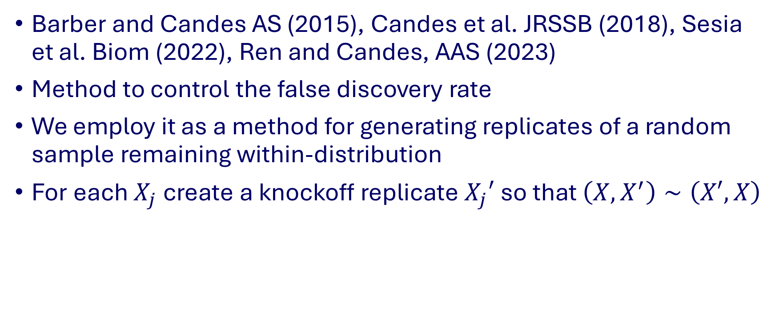
Knockoffs
Barber and Candes AS (2015), Candes et al. JRSSB (2018), Sesia et al. Biom (2022), Ren and Candes, AAS (2023)
Method to control the false discovery rate
We employ it as a method for generating replicates of a random sample remaining within-distribution
For each $X_{j}$ create a knockoff replicate $X_{j}′$ so that $\left(X,X^{′}\right)∼\left(X′,X\right)$

Slide 21
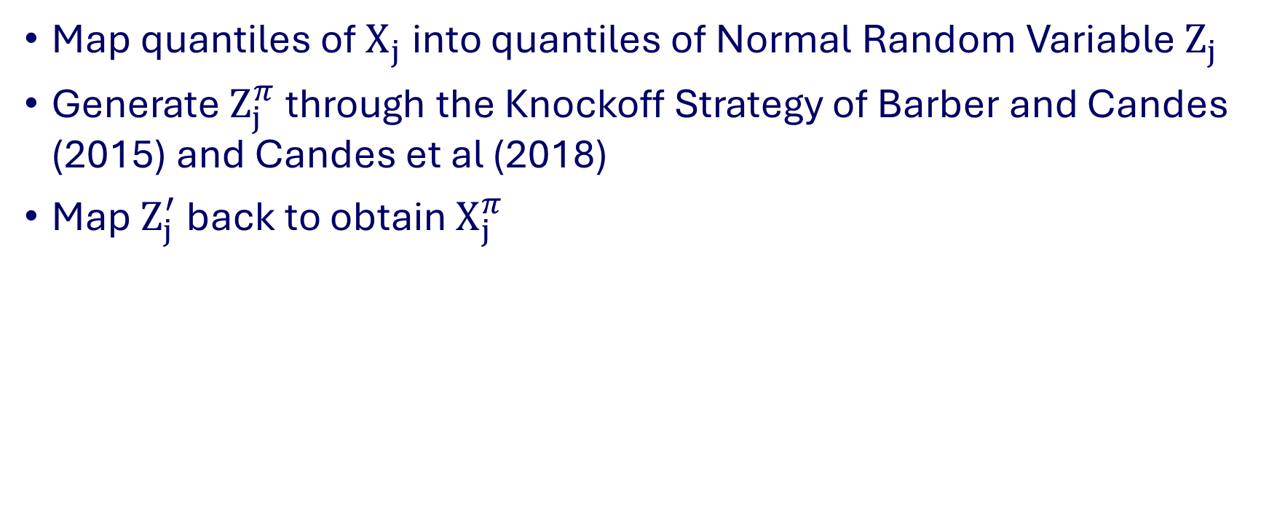
The GKnock Algorithm
Map quantiles of$X_{j}$ into quantiles of Normal Random Variable $Z_{j}$
Generate $Z_{j}^{π}$ through the Knockoff Strategy of Barber and Candes (2015) and Candes et al (2018)
Map $Z_{j}^{′}$ back to obtain $X_{j}^{π}$

Slide 22
Original Data
Within Distribut.
New Data (X’)
Impossible
Far
Notes:
Here let us recall to say that if we did not use the transformation, the knockoffs by themselves would not work. We “save” the knockoffs placing them in the “normal” world, where they work!

Slide 23
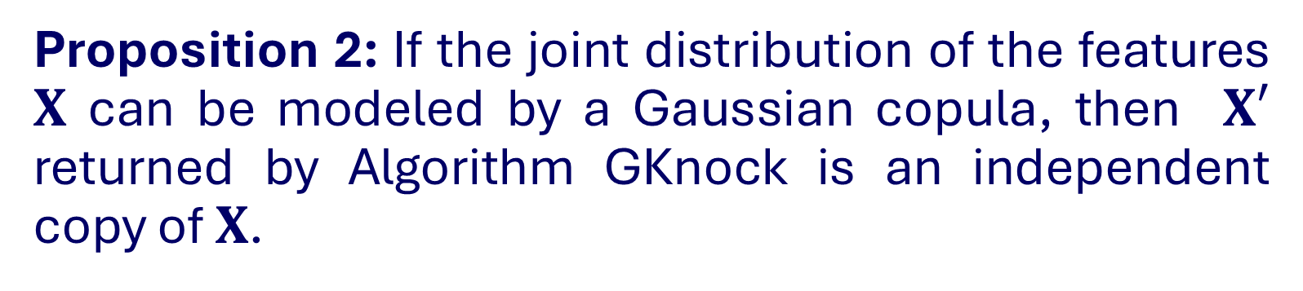
Theoretical Guarantee
Proposition 2: If the joint distribution of the features $X$ can be modeled by a Gaussian copula, then $X′$ returned by Algorithm GKnock is an independent copy of $X$.
Notes:
That’s much more fleible

Slide 24

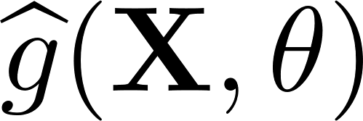
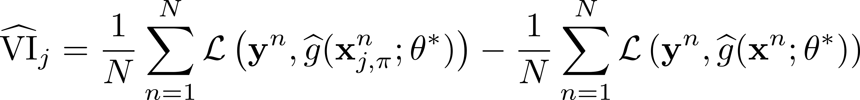
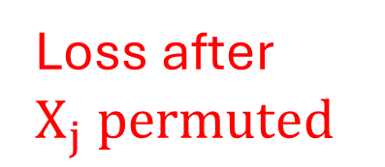
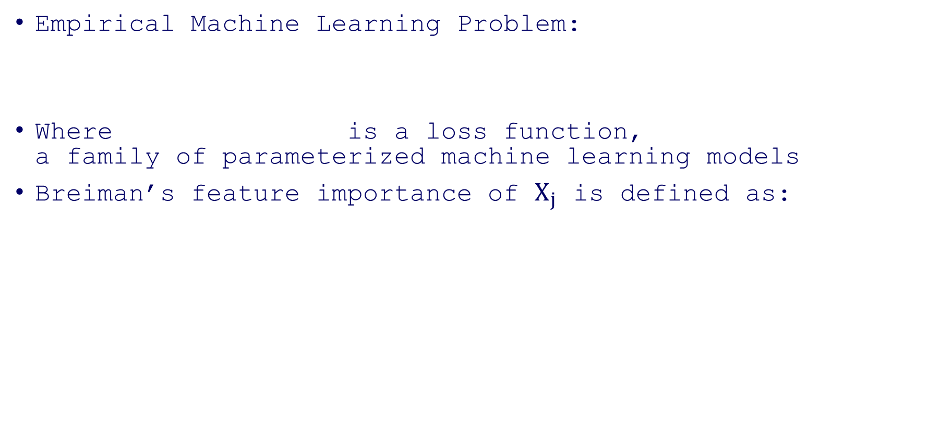
Permutation Variable Importance
Empirical Machine Learning Problem:
Where is a loss function, a family of parameterized machine learning models
Breiman’s feature importance of $X_{j}$ is defined as:
Loss after $X_{j} permuted$
Original Loss

Slide 25
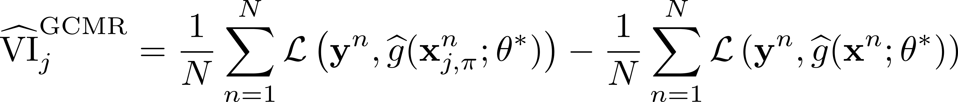
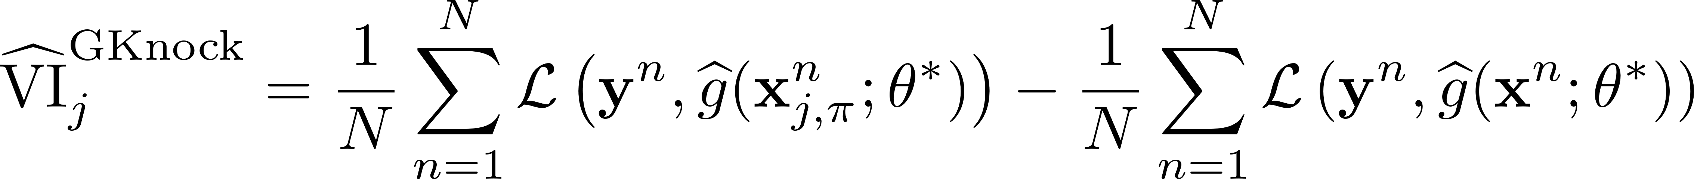
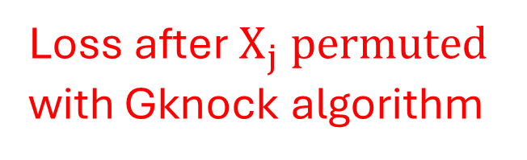
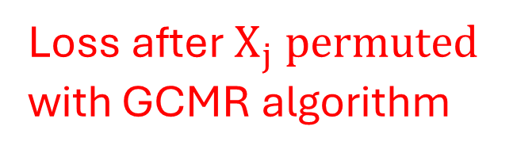
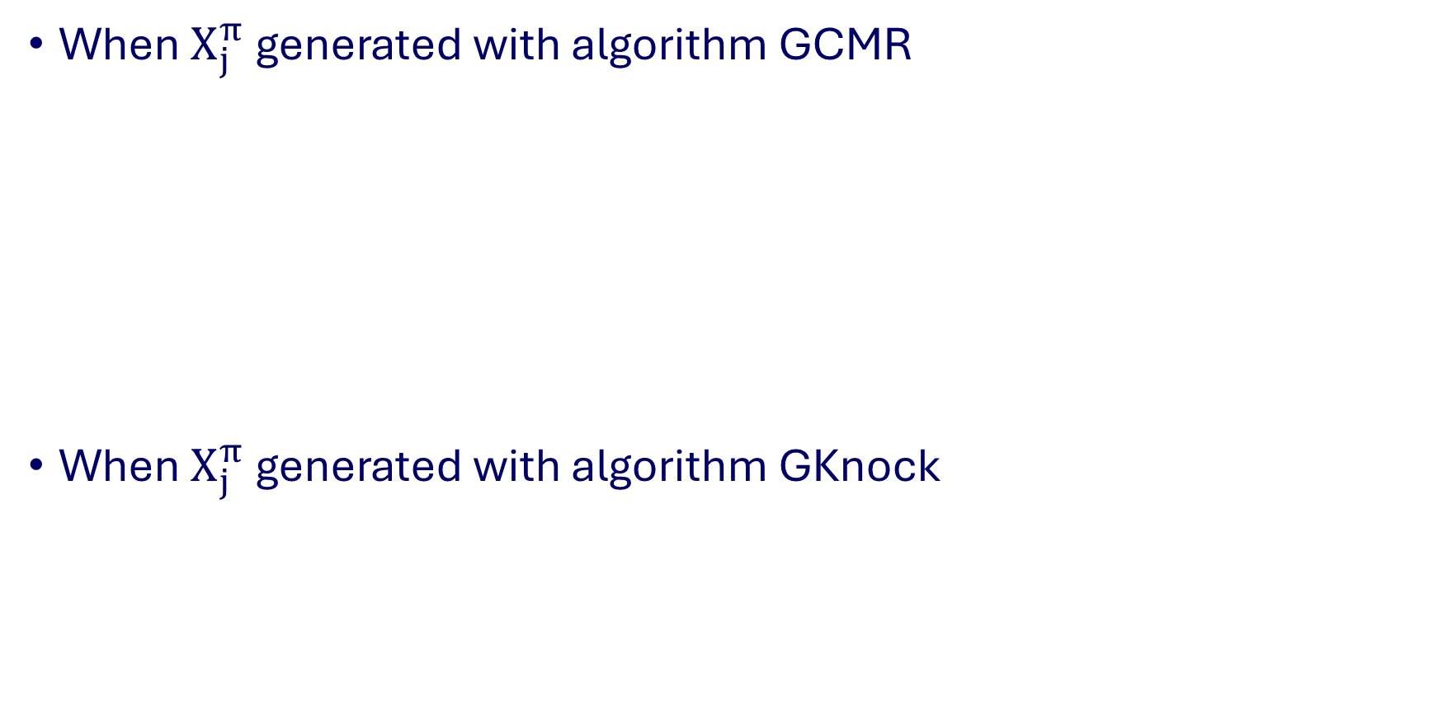
New Permutation Importance Measures
When $X_{j}^{π}$ generated with algorithm GCMR
When $X_{j}^{π}$ generated with algorithm GKnock
Loss after $X_{j} permuted$
with GCMR algorithm
Original Loss
Loss after $X_{j} permuted$
with Gknock algorithm
Original Loss

Slide 26
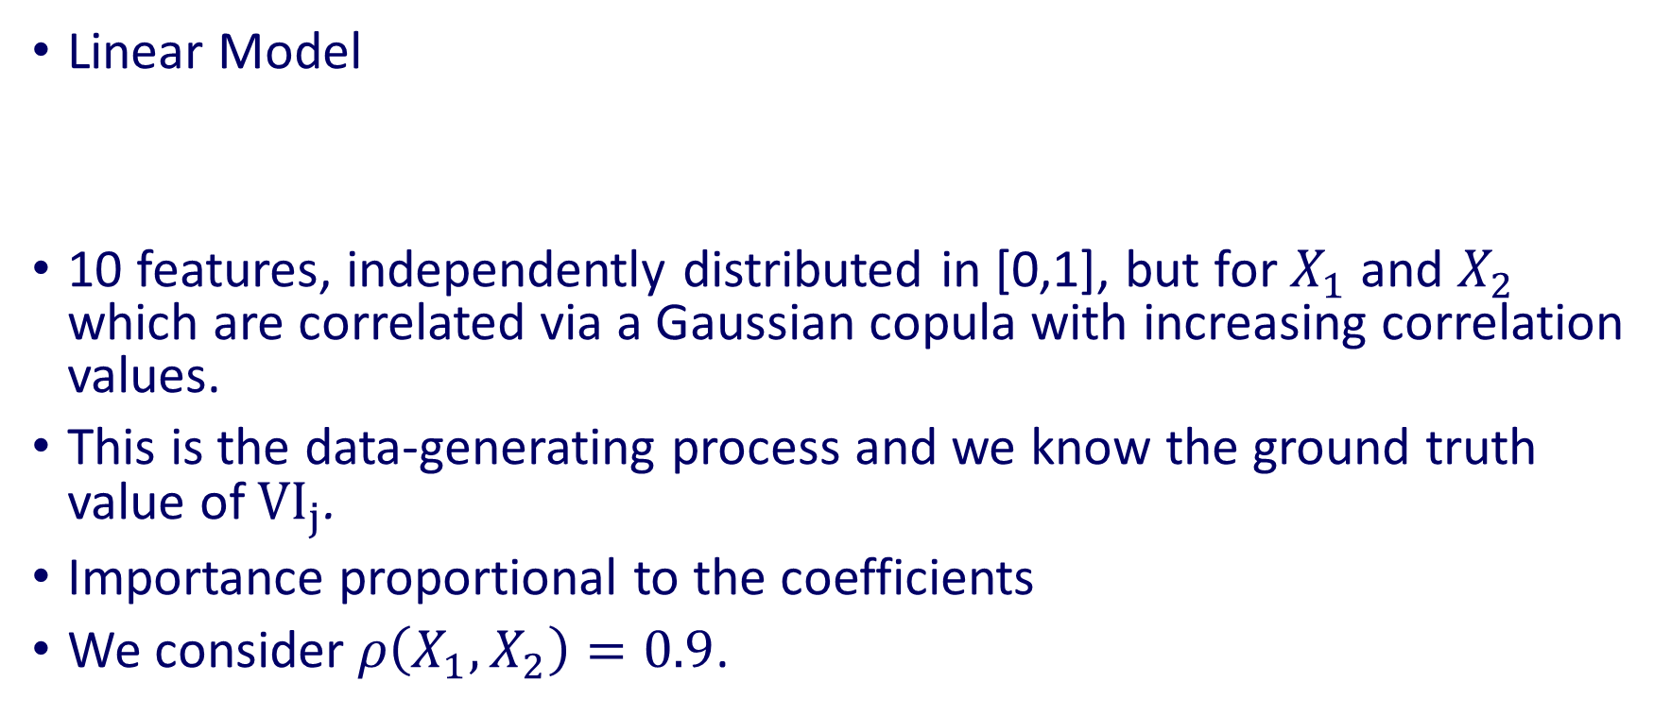
Test Case: Hooker et al. (2021)
Linear Model
10 features, independently distributed in [0,1], but for $X_{1}$ and $X_{2}$ which are correlated via a Gaussian copula with increasing correlation values.
This is the data-generating process and we know the ground truth value of $VI_{j}$.
Importance proportional to the coefficients
We consider $ρ\left(X_{1},X_{2}\right)=0.9$.

Slide 27
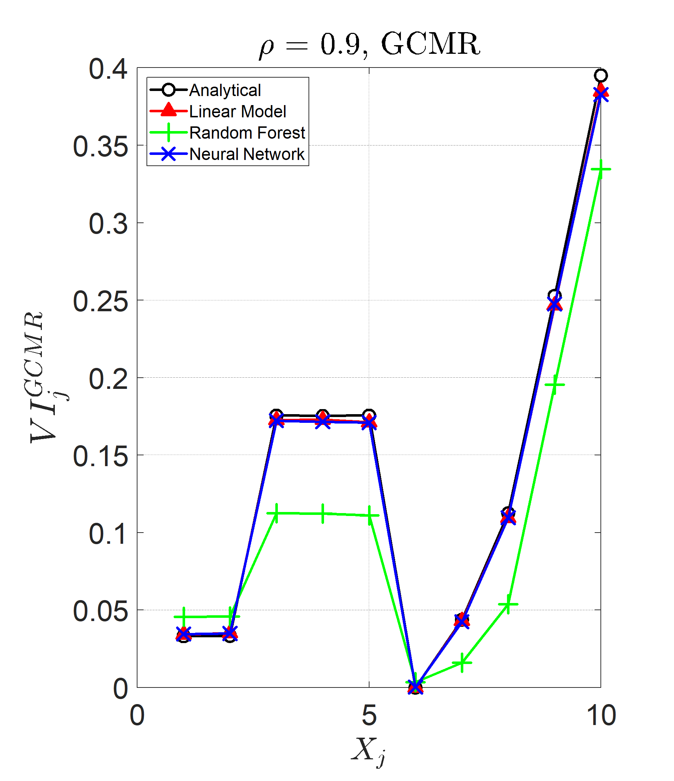
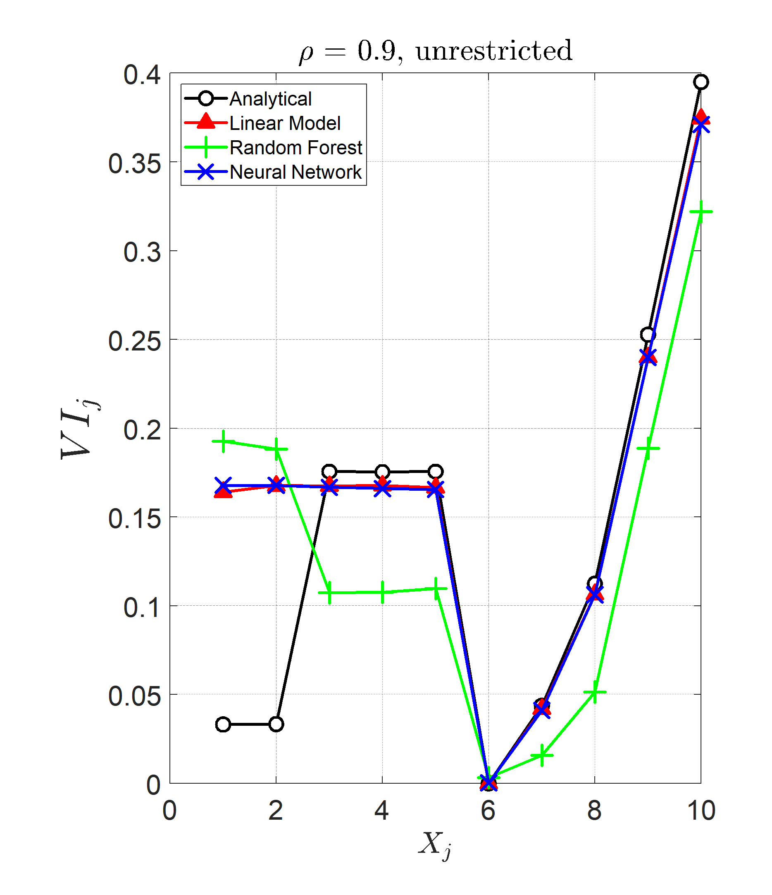
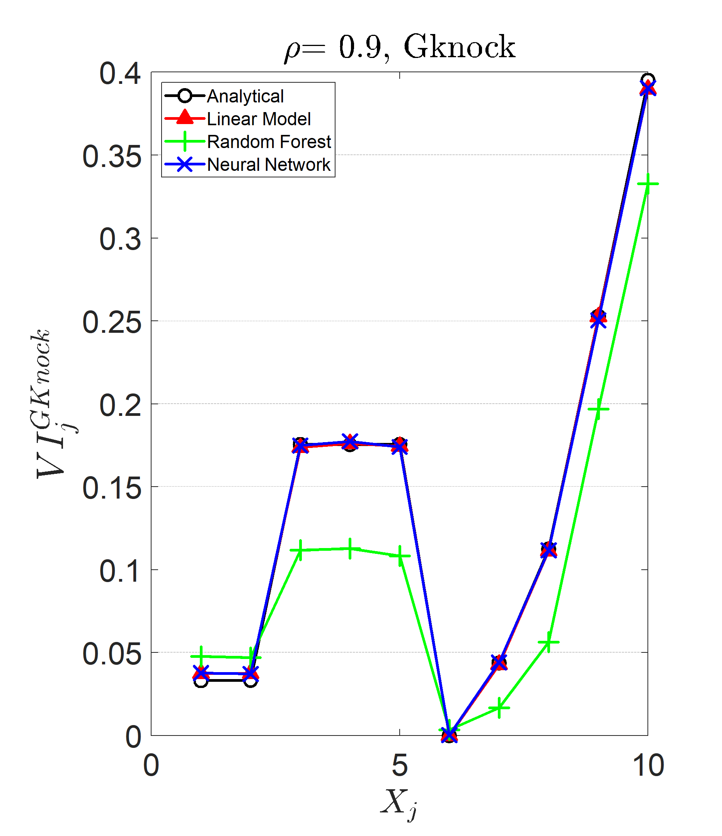
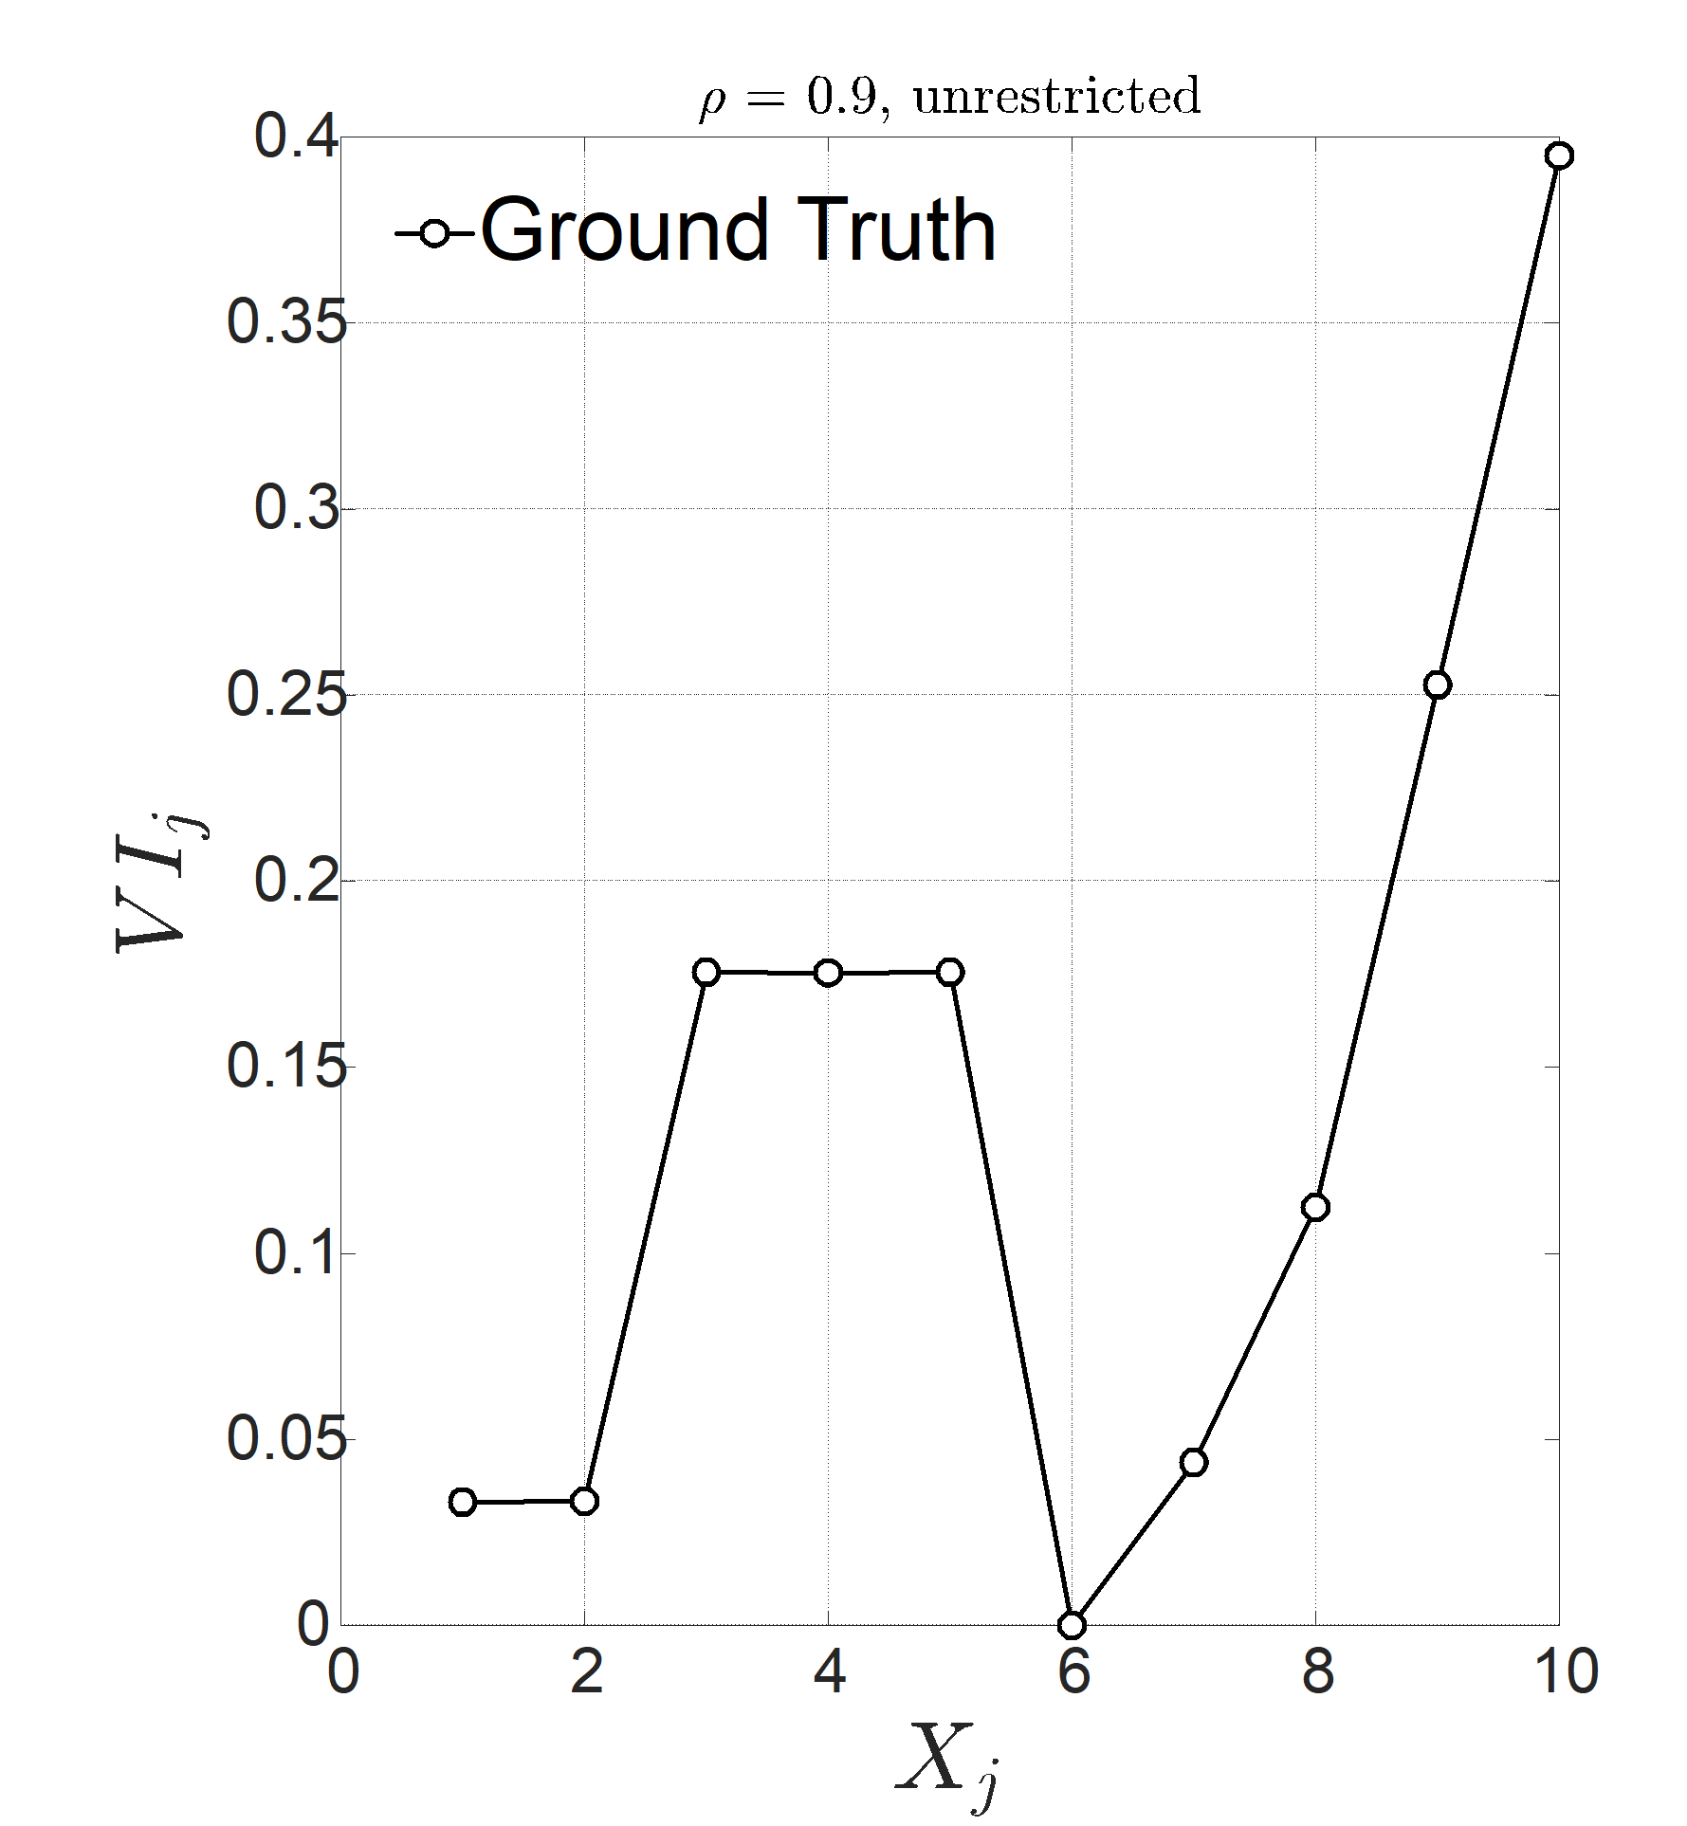

Unrestricted Permutations (${VI}_{j})$
VI Estimate
too High!
VI Estimate
correct!
Ground Truth
Notes:
We want our method to give us this

Slide 28
Why?
Under quadratic loss VI is (surprisingly) a total index
Without permutation restrictions you go “out of distribution”
Our VI’s remain “within distribution”
An important class of statistical association measures
Notes:
Say that total indices are the expected variance reduction if you fix all variables but yours; I am going to show you this in the next couple of slides

Slide 29
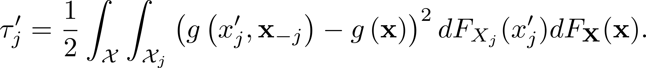
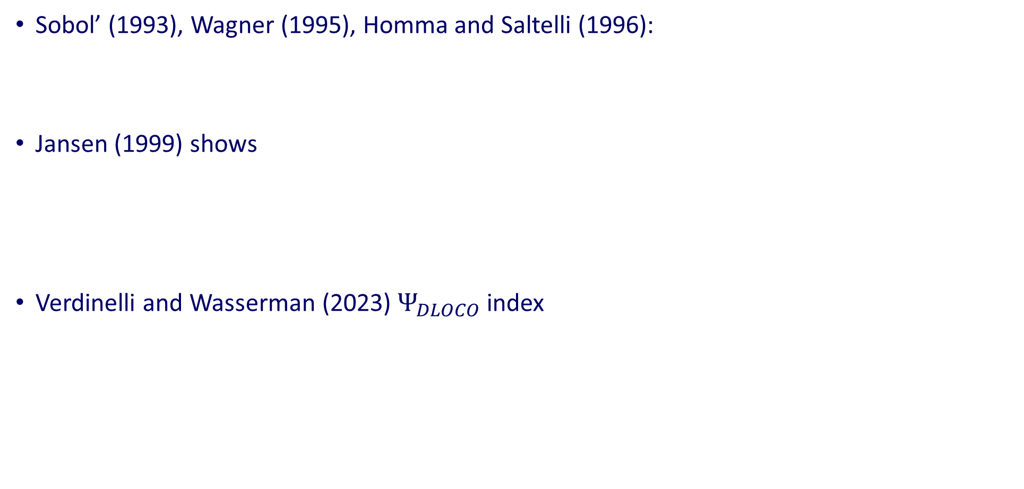
What are Total Indices?
Sobol’ (1993), Wagner (1995), Homma and Saltelli (1996):
Jansen (1999) shows
Verdinelli and Wasserman (2023) $Ψ_{DLOCO}$ index
Within Distribution
Out of Distribution
Ignores correlations
Notes:
It is what we do not want

Slide 30
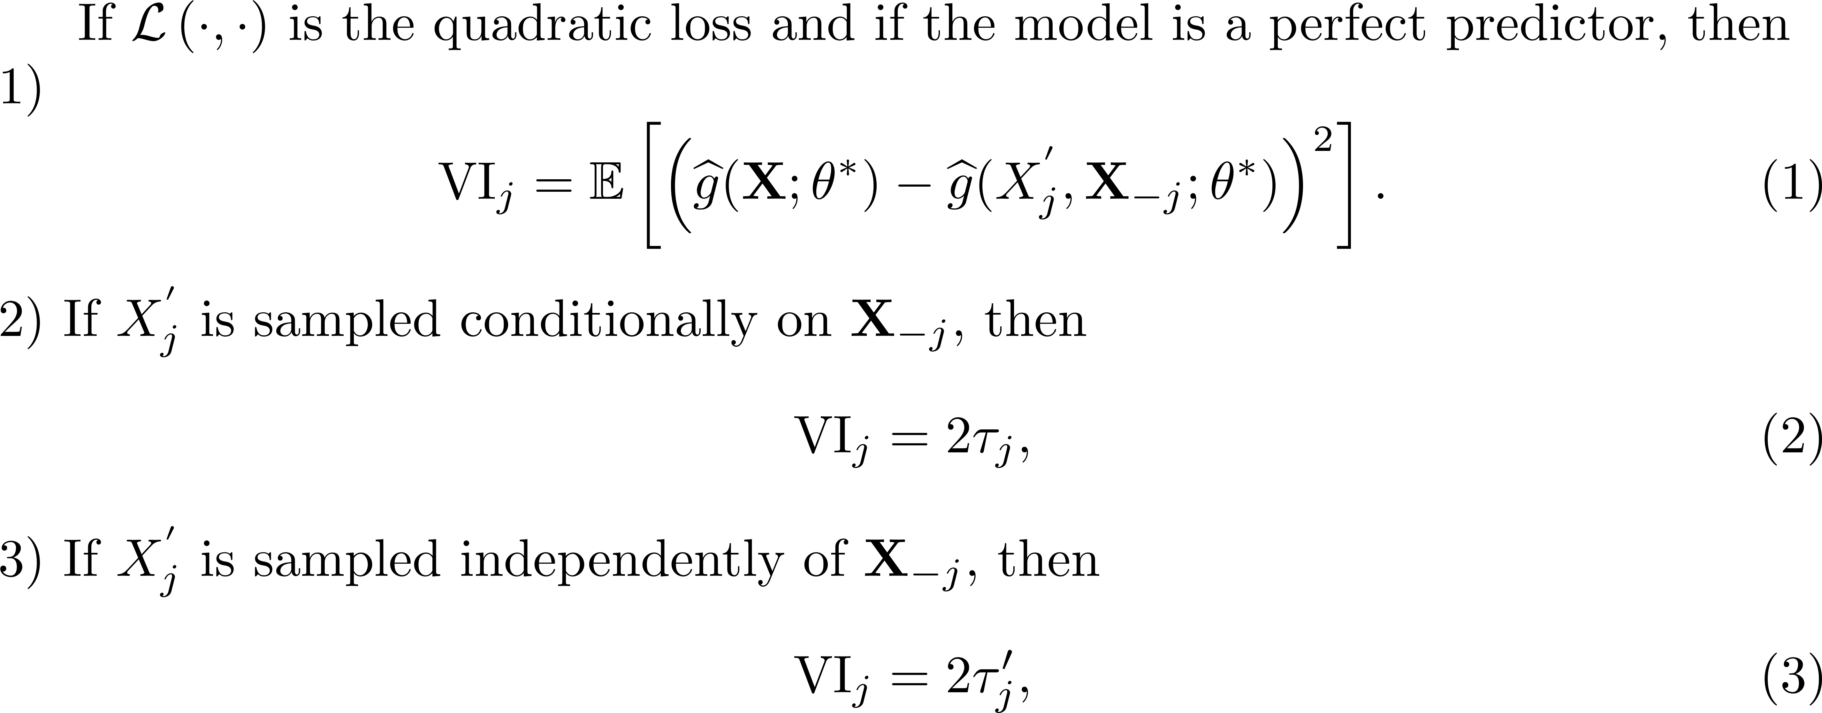
The Mathematical Link
Theorem 1:
Classical Total index
GCMR and GKnock →
Verdinelli and Wasserman
index
Breiman VI →
Notes:
Our theorem is: condinionally means correctly; our importance measures find the correct quantity; if you compute Breiman you are computing Verdinelli

Slide 31
Boston Housing

Slide 32
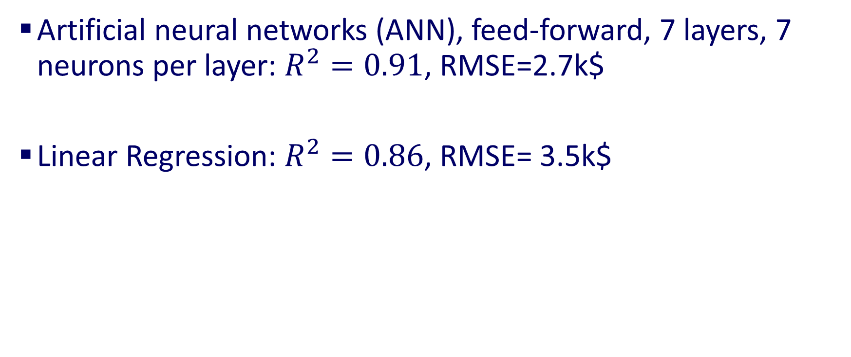
Three Machine Learning Models
Artificial neural networks (ANN), feed-forward, 7 layers, 7 neurons per layer: $R^{2}=0.91$, RMSE=2.7k$
Linear Regression: $R^{2}=0.86$, RMSE= 3.5k$

Slide 33
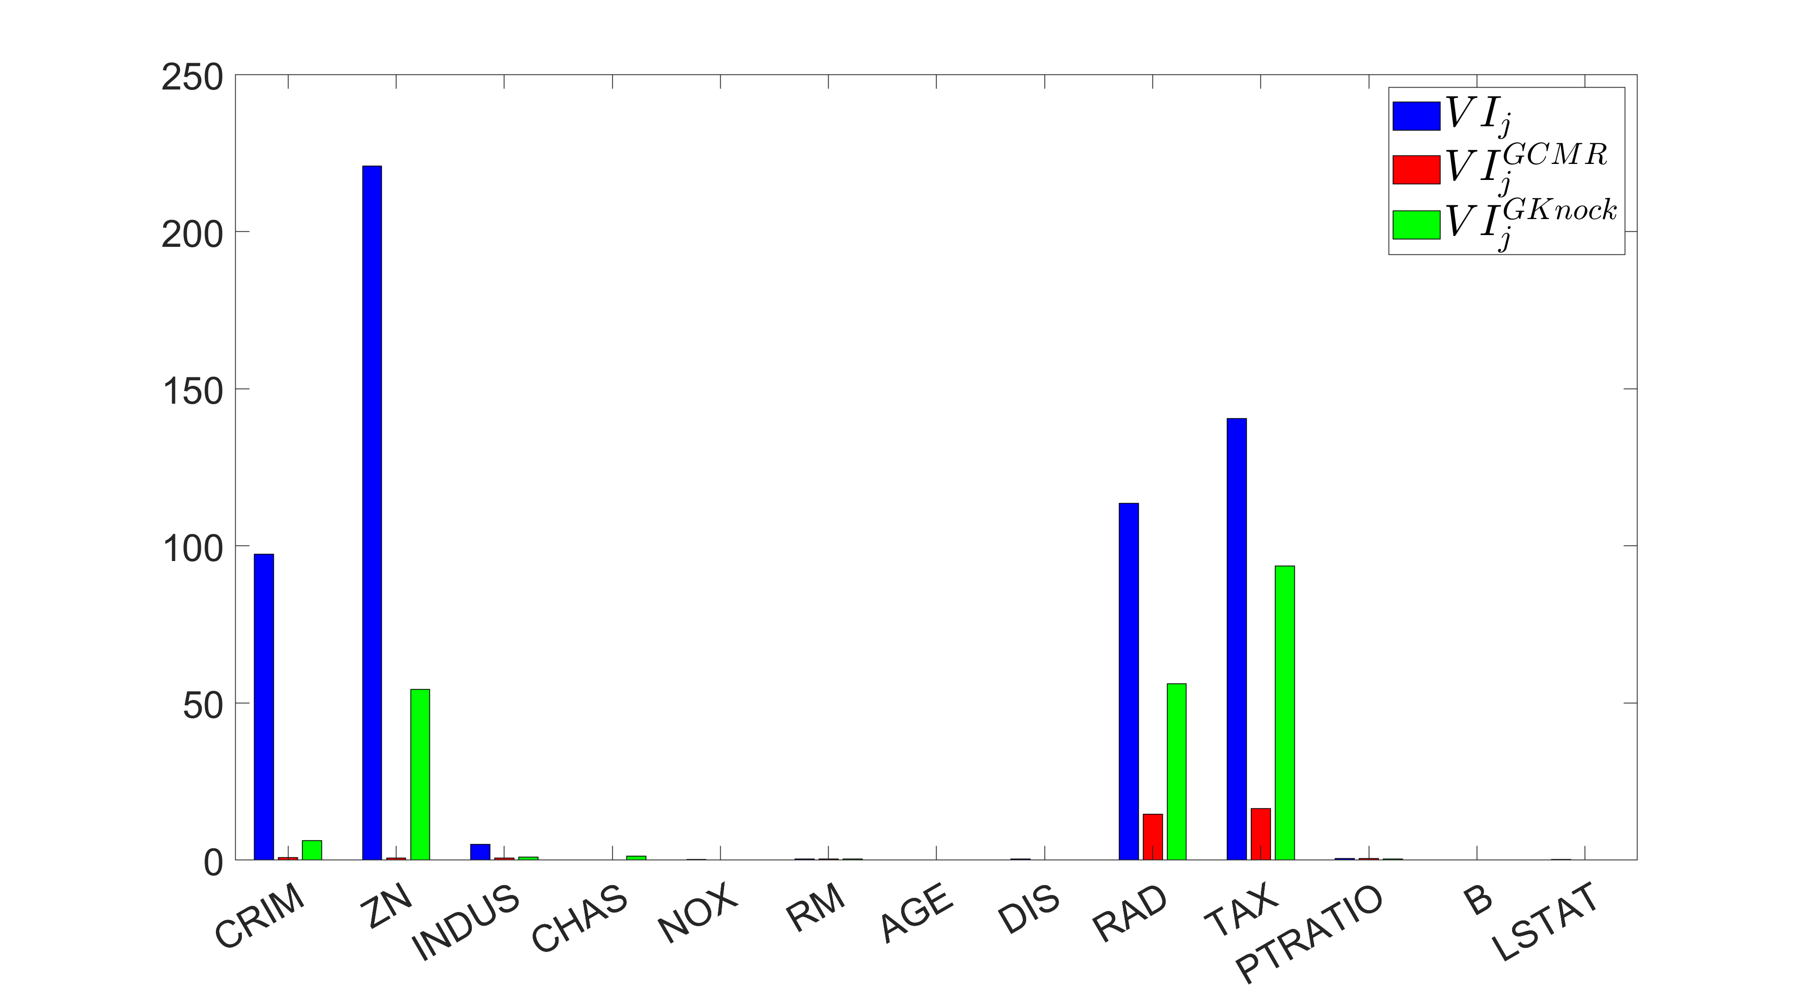
Linear Regression, $VI_{j}$ , $VI_{j}^{GCMR}$ and $VI_{j}^{GKnock}$

Slide 34
Implied Model Predictions
Long tail of unreliable predictions
(strong extrapolation!)
No more tail:
Within distribution
Notes:
Cut out the titles in the images

Slide 35
SHAPs for Linear Regression
Wrong importance due to extrapolation
Notes:
Eliminate the title

Slide 36

Neural Network, $VI_{j}$ , $VI_{j}^{GCMR}$ and $VI_{j}^{GKnock}$

Slide 37
Name Ethnicity
The Dataset:
Primary dataset for name-based ethnicity classification, for fairness calculations
13 Million entries, 4 ethnicities: Asian 1.9%, Black 14.2%, Hispanic 16.7%, and White 67.1%.
30 meaningful features used in Jain et al (2022).
ML Model in this work: Neural Network
Variable importance
SHAPs not computationally feasible (8 hours for only 2500 entries)
Permutation-based importance measures require just a few minutes
Notes:
And we have 13 millions of them look for the time

Slide 38

${VI}_{j}$ unrestricted: results

Slide 39

${VI}_{j}^{GCMR}$: Ranking for the ANN

Slide 40

${VI}_{j}^{GKnock}$: Ranking for the ANN

Slide 41
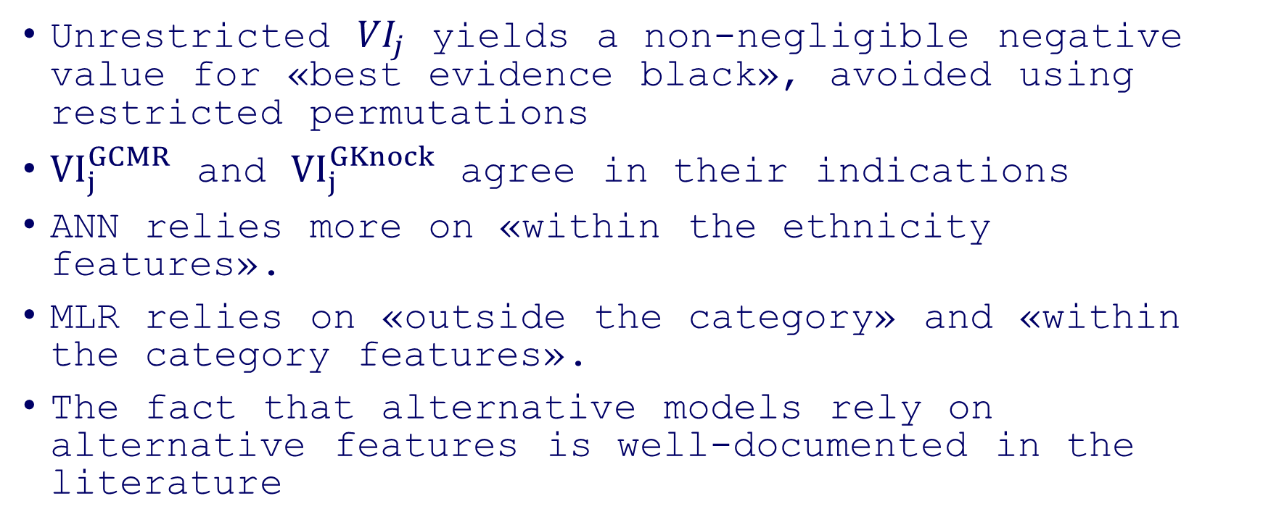
Summary for Ethnicity
Unrestricted ${VI}_{j}$ yields a non-negligible negative value for «best evidence black», avoided using restricted permutations
${VI}_{j}^{GCMR}$ and ${VI}_{j}^{GKnock}$ agree in their indications
ANN relies more on «within the ethnicity features».
MLR relies on «outside the category» and «within the category features».
The fact that alternative models rely on alternative features is well-documented in the literature

Slide 42

Final Remarks
Variable importance is key for explainability
We solved a long-standing problem
Two new strategies
Easy to implement, computationally efficient
Proved theoretical guarantees on staying in distribution
Proved direct interpretation in terms of total Indices
Computational Experiments:
Effective in eliminating extrapolation
Reliable: Yield sensible indications (important when there is no ground truth available)
Thank you!
Available at: https://github.com/emanueleborgonovo/TrustworthyFeatureImportanceMeasures
Notes:
How to eliminate extrapolation

